Slide 1
Unit 4
Frames

Slide 2
What is Frame??
HTML frames are used to divide our browser window into multiple sections where each section can load a separate HTML document.
A collection of frames in the browser window is known as a frameset.
The window is divided into frames in a similar way the tables are organized: into rows and columns.

Slide 3
Creating Frames
To use frames on a page we use <frameset> tag instead of <body> tag.
The <frameset> tag defines, how to divide the window into frames.
The rows attribute of <frameset> tag defines horizontal frames and cols attribute defines vertical frames.
Each frame is indicated by <frame> tag and it defines which HTML document shall open into the frame.

Slide 4
Disadvantages of Frames
There are few drawbacks with using frames, so it's never recommended to use frames in our webpages −
Some smaller devices cannot cope with frames often because their screen is not big enough to be divided up.
Sometimes our page will be displayed differently on different computers due to different screen resolution.
The browser's back button might not work as the user hopes.
There are still few browsers that do not support frame technology.

Slide 5
The advantages of HTML frames
The main advantage of frames is that it allows the user to view multiple documents within a single Web page.
It is possible to load pages from different servers in a single frameset.
The concern that older browsers do not support frames can be addressed using the <noframe> tag.
This tag provides a section in an HTML document to include alternative content for browsers without support for frames.
However, it requires that the Web designer provide two formats for one page.

Slide 6
The <frameset> Tag Attributes
cols | Specifies how many columns are contained in the frameset and the size of each column. Absolute values in pixels. For example, to create three vertical frames, use cols = "100, 500, 100". A percentage of the browser window. For example, to create three vertical frames, use cols = "10%, 80%, 10%".
rows | This attribute works just like the cols attribute and takes the same values, but it is used to specify the rows in the frameset.
border | This attribute specifies the width of the border of each frame in pixels. For example, border = "5". A value of zero means no border.
frameborder | This attribute specifies whether a three-dimensional border should be displayed between frames. This attribute takes value either 1 (yes) or 0 (no). For example frameborder = "0" specifies no border.

Slide 7
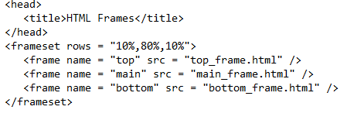

Slide 8
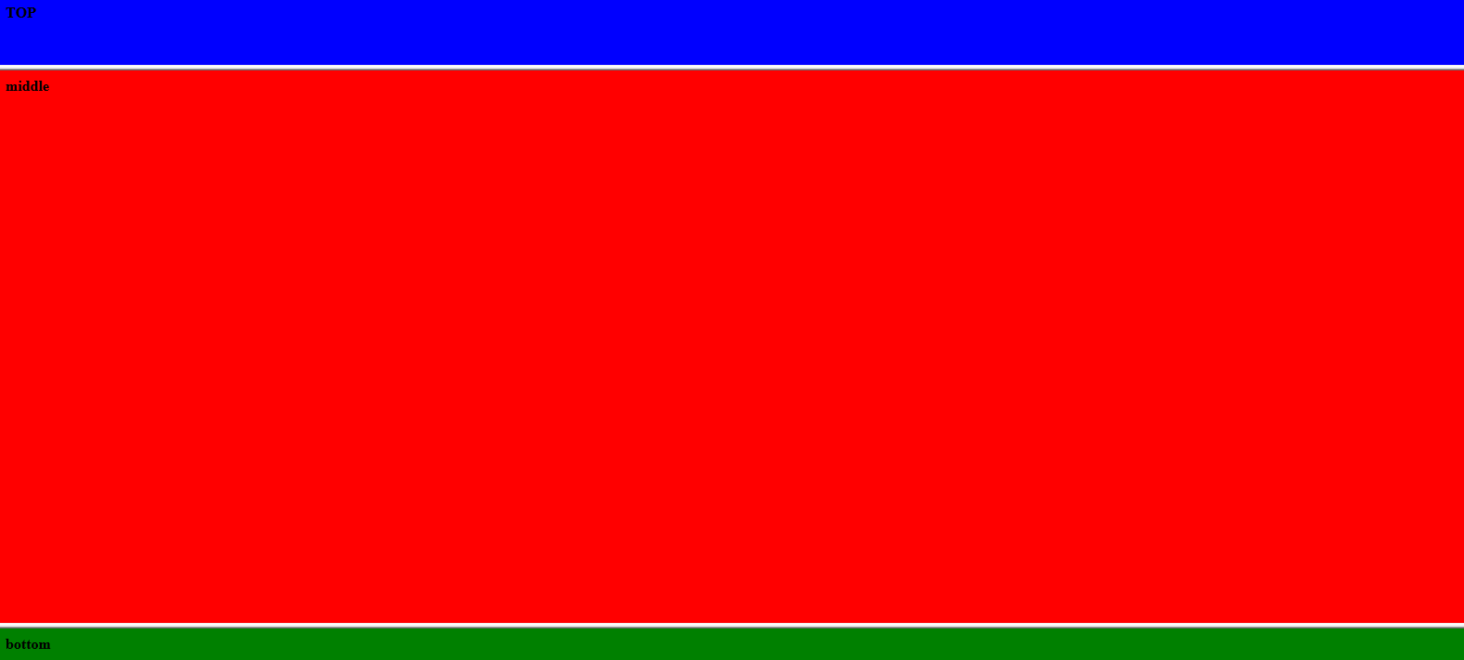
Demo of frameset in rows

Slide 9
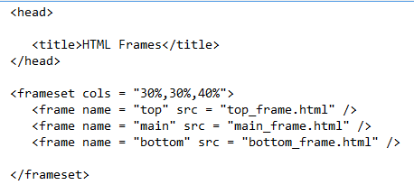
Demo of frameset in columns

Slide 10
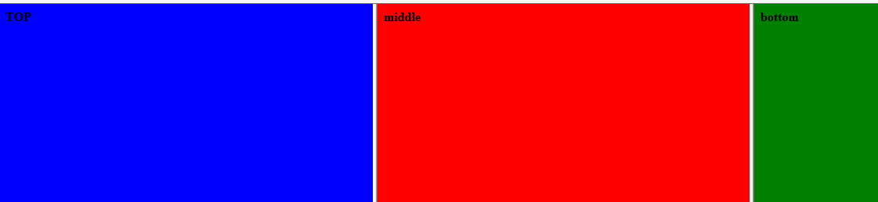

Slide 11
The <noframes> tag is a fallback tag for browsers that do not support frames.
It can contain all the HTML elements that we can find inside the <body> element of a normal HTML page.
The <noframes> element can be used to link to a non-frameset version of the web site or to display a message to users that frames are required.
The <noframes> element goes inside the <frameset> element.

Slide 12
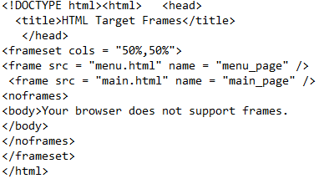
Use of <noframe> tag

Slide 13


Slide 14
Another Example of <noframe> Linking to document
<html>
<head>
<title>This is a frameset document.</title>
</head>
<frameset>
<frame src="sample-a.html" name="frame-a">
<frame src="sample-b.html" name="frame-b">
<noframes>
<p>Here is the <a href="noframes.html">non-frame based version of the document.</a></p>
</noframes>
</frameset>
</html>

Slide 15
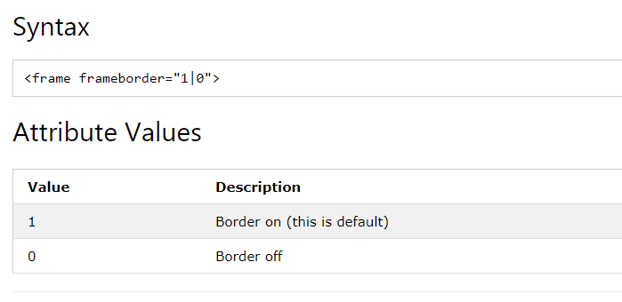
Frameborder
The frameborder attribute specifies whether or not to display a border around a frame.

Slide 16
<html>
<head>
<title>Example of HTML frameborder attribute with frame</title>
</head>
<frameset cols="20%,*,20%">
<frame src="frame_left.htm" frameborder="0" ></frame>
<frame src="frame_center.htm" frameborder="0" ></frame>
<frame src="frame_right.htm" frameborder="0" ></frame>
</frameset>
</html>

Slide 17
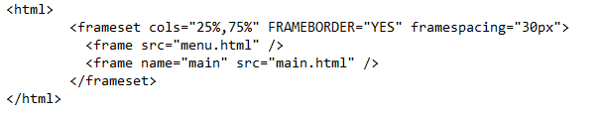

Slide 19
Continue…..

Slide 20
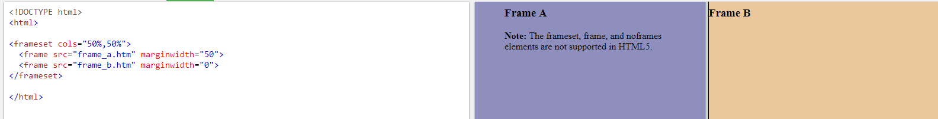
Marginwidth attribute
The marginwidth attribute specifies the width between the content and the left and right sides of the frame, in pixels.

Slide 21
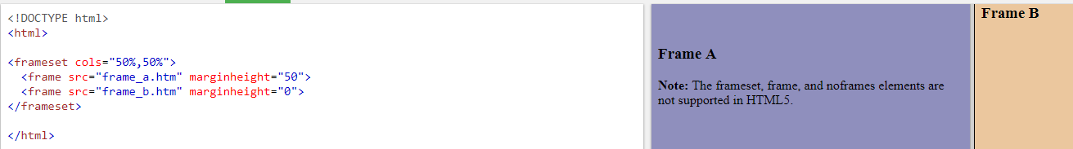
The marginheight attribute specifies the height between the content and the top and bottom of the frame, in pixels.

Slide 22
Resize attribute in frame
The noresize attribute specifies that a <frame> element cannot be resized by the user.
By default, each <frame> in a <frameset> can be resized by dragging the border between the frames.
However, this attribute locks the size of a frame.

Slide 23
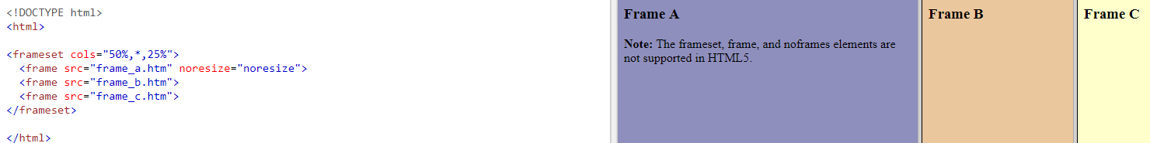
Here frame A cannot be resized but frame B &C can be resized

Slide 24
HTML <frame> scrolling Attribute
The scrolling attribute specifies whether or not to display scrollbars in a <frame>.
By default, scrollbars appear in a <frame> if the content is larger than the <frame>.

Slide 25
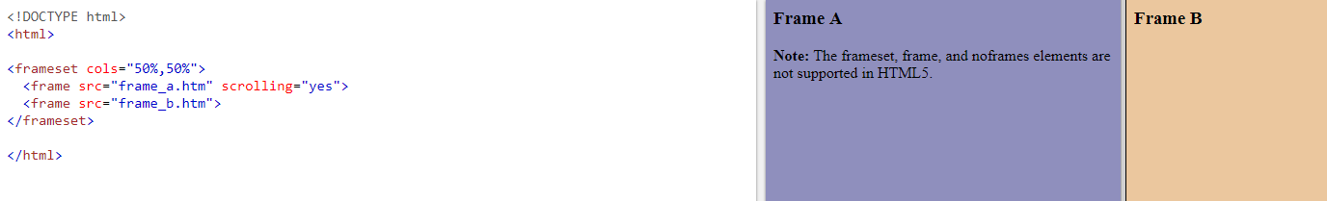
Demo of scrolling attribute

Slide 26
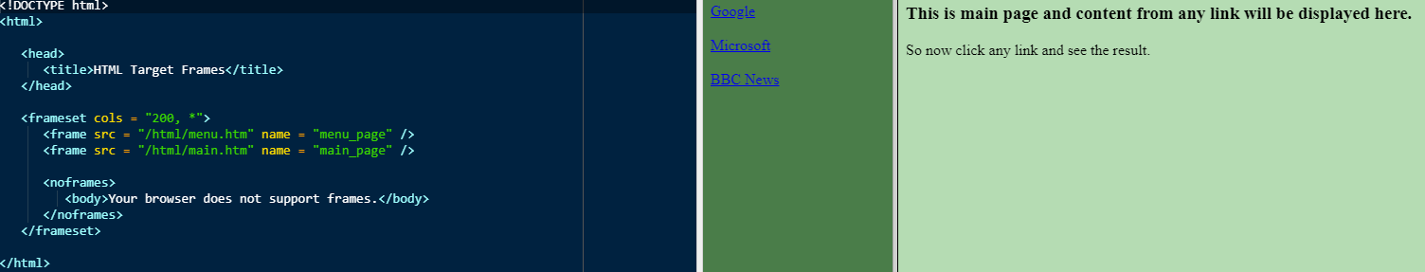
Target attribute in frame

Slide 27
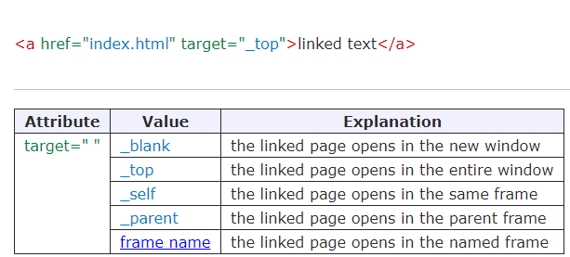

Slide 28
The <frameset> Tag Attributes
cols | Specifies how many columns are contained in the frameset and the size of each column. Absolute values in pixels. For example, to create three vertical frames, use cols = "100, 500, 100". A percentage of the browser window. For example, to create three vertical frames, use cols = "10%, 80%, 10%".
rows | This attribute works just like the cols attribute and takes the same values, but it is used to specify the rows in the frameset.
border | This attribute specifies the width of the border of each frame in pixels. For example, border = "5". A value of zero means no border.
frameborder | This attribute specifies whether a three-dimensional border should be displayed between frames. This attribute takes value either 1 (yes) or 0 (no). For example frameborder = "0" specifies no border.

Slide 29
The <frame> Tag Attributes
src | This attribute is used to give the file name that should be loaded in the frame. Its value can be any URL. For example, src = "/html/top_frame.htm" will load an HTML file available in html directory.
name | This attribute allows we to give a name to a frame. It is used to indicate which frame a document should be loaded into. This is especially important when we want to create links in one frame that load pages into an another frame, in which case the second frame needs a name to identify itself as the target of the link.
marginwidth | This attribute allows we to specify the width of the space between the left and right of the frame's borders and the frame's content. The value is given in pixels. For example marginwidth = "10".
marginheight | This attribute allows we to specify the height of the space between the top and bottom of the frame's borders and its contents. The value is given in pixels. For example marginheight = "10".
scrolling | This attribute controls the appearance of the scrollbars that appear on the frame. This takes values either "yes", "no" or "auto". For example scrolling = "no" means it should not have scroll bars.

Slide 30
Browser Support for Frames
If a user is using any old browser or any browser, which does not support frames then <noframes> element should be displayed to the user.
So we must place a <body> element inside the <noframes> element because the <frameset> element is supposed to replace the <body> element, but if a browser does not understand <frameset> element then it should understand what is inside the <body> element which is contained in a <noframes> element.
we can put some nice message for our user having old browsers. For example, Sorry!! our browser does not support frames. as shown in the above example.

Slide 31
HTML - Iframes
we can define an inline frame with HTML tag <iframe>.
The <iframe> tag is not somehow related to <frameset> tag, instead, it can appear anywhere in our document.
The <iframe> tag defines a rectangular region within the document in which the browser can display a separate document, including scrollbars and borders.
An inline frame is used to embed another document within the current HTML document.

Slide 32
We can define an inline frame with HTML tag <iframe>.
The <iframe> tag is not somehow related to <frameset> tag, instead, it can appear anywhere in our document.
The <iframe> tag defines a rectangular region within the document in which the browser can display a separate document, including scrollbars and borders.

Slide 33
An inline frame is used to embed another document within the current HTML document.
The src attribute is used to specify the URL of the document that occupies the inline frame.

Slide 34


Slide 35
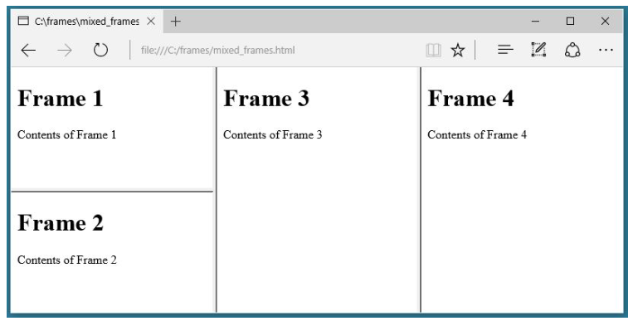
Mixed frameset
<frameset cols="*,*,*">
<frameset rows="*,*">
<frame src="frame_1.html">
<frame src="frame_2.html">
</frameset>
<frame src="frame_3.html">
<frame src="frame_4.html">
< /frameset>

Slide 36
Frame a
Frame b
Frame c
<html>
<frameset rows="50%,50%">
<frame src="frame_a.htm">
<frameset cols="25%,75%">
<frame src="frame_b.htm">
<frame src="frame_c.htm">
</frameset>
</frameset>
</html>

Slide 37
frame_a
frame_b
frame_c
frame_d
<html>
<frameset rows="50%,50%">
<frameset cols="50%,50%">
<frame src="frame_a.htm">
<frame src="frame_b.htm">
</frameset>
<frameset cols="50%,50%">
<frame src="frame_c.htm">
<frame src="frame_d.htm">
</frameset>
</frameset>
</html>

